Slide 1
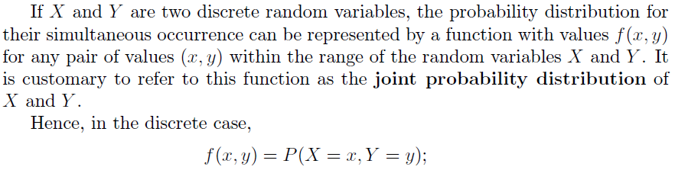

Slide 2
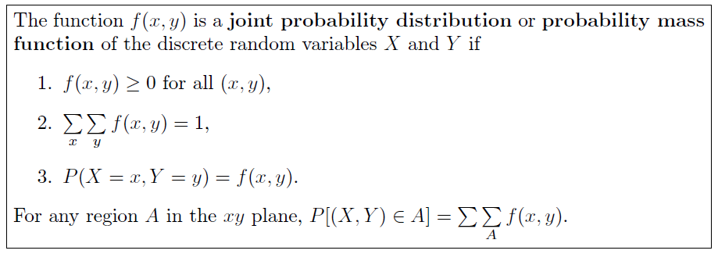

Slide 3
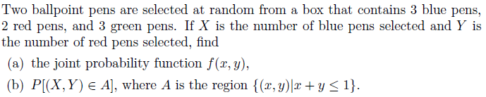
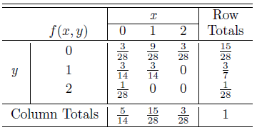
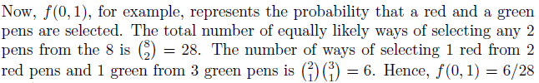

Slide 4

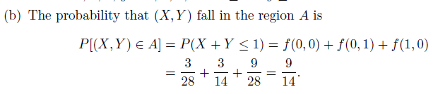

Slide 5
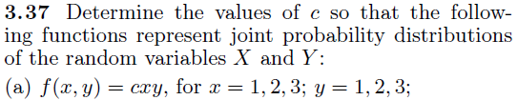

Slide 6

As we can see that this is discrete random variable so using the property
$$\sum_{x}{\sum_{y}{f\left(x,y\right)}=1}$$
to find the value of $c$.
$$\sum_{x=1}^{3}{\sum_{y=1}^{3}{cxy=1}}$$
So,
$f(1,1)+f(1,2)+f(1,3)+f(2,1)+f(2,2)+f(2,3)+f(3,1)+f(3,2)+f(3,3)=1$
$c\left(1\right)\left(1\right)+c\left(1\right)\left(2\right)+c\left(1\right)\left(3\right)+c\left(2\right)\left(1\right)+c\left(2\right)\left(2\right)+c\left(2\right)\left(3\right)+c(3)(1)+c(3)(2)+c(3)(3)=1$
$c+2c+3c+2c+4c+6c+3c+6c+9c=1$
$36c=1$
$c=$ $\frac{1}{36}$

Slide 7
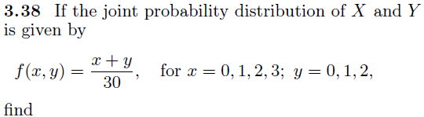
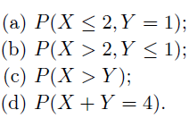

Slide 8
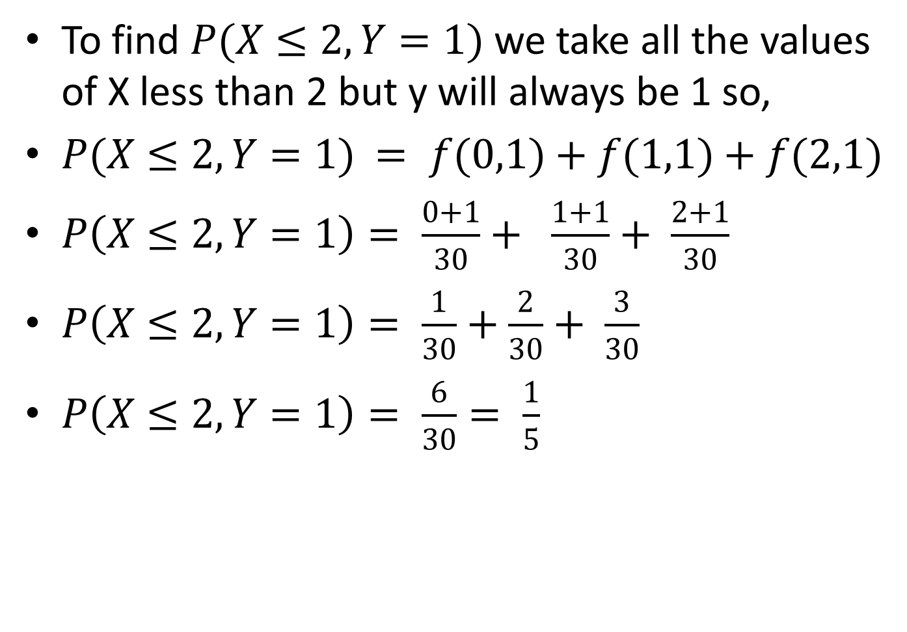
To find $P(X≤2, Y=1)$ we take all the values of X less than 2 but y will always be 1 so,
$P(X≤2, Y=1)$ $= f(0,1)+f(1,1)+f(2,1)$
$P\left(X≤2, Y=1\right)= \frac{0+1}{30}+ \frac{1+1}{30}+ \frac{2+1}{30}$
$P\left(X≤2, Y=1\right)= \frac{1}{30}+\frac{2}{30}+ \frac{3}{30}$
$P\left(X≤2, Y=1\right)= \frac{6}{30}= \frac{1}{5}$

Slide 9
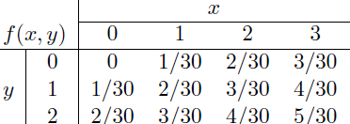
Another way to find is to construct the Joint Probability Distribution Function.

Slide 10
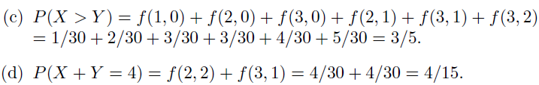

Slide 11
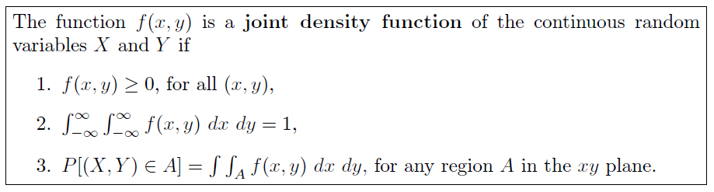

Slide 12
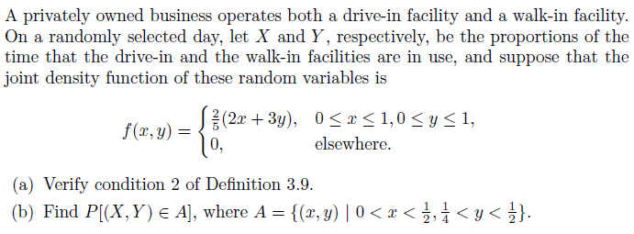
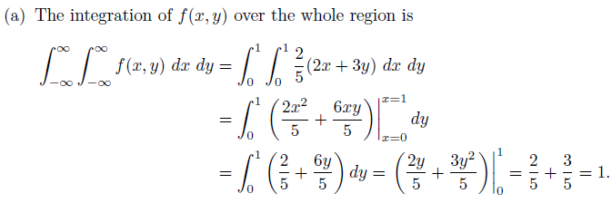

Slide 13
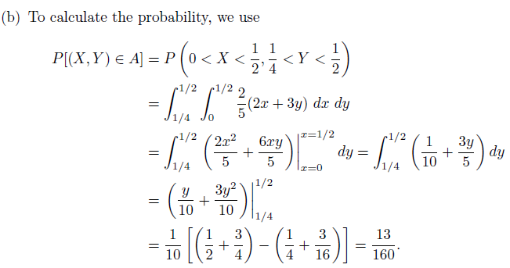

Slide 14
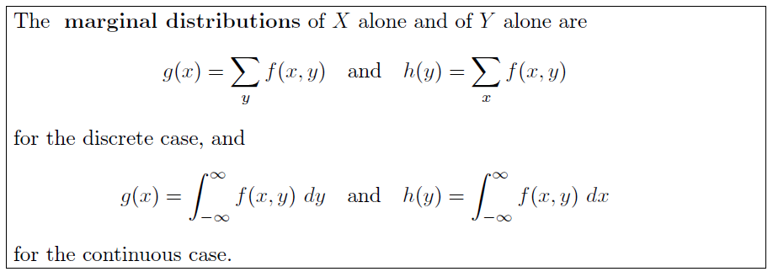
MARGINAL DISTRIBUTION

Slide 15
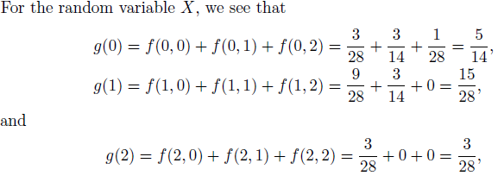
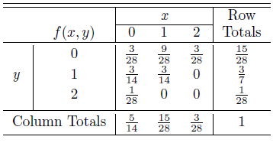

Slide 16

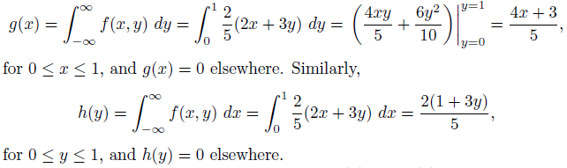

Slide 17
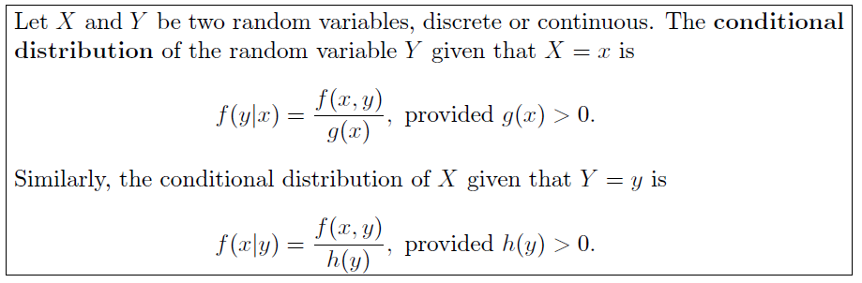
CONDITIONAL DISTRIBUTION

Slide 18

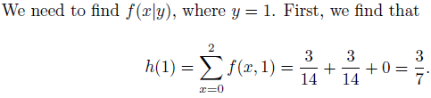


Slide 19
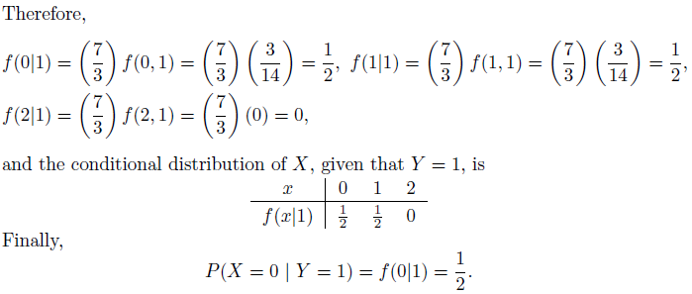

Slide 20
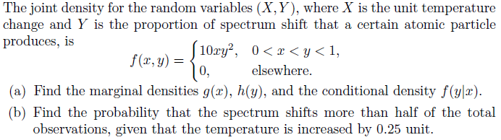
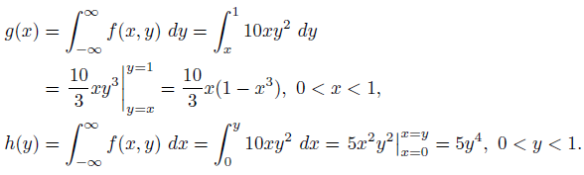

Slide 21

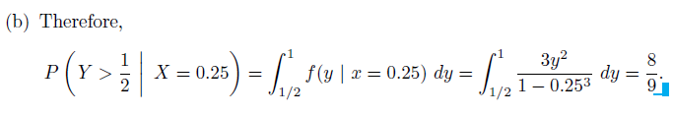

Slide 22
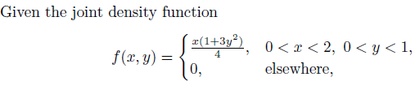
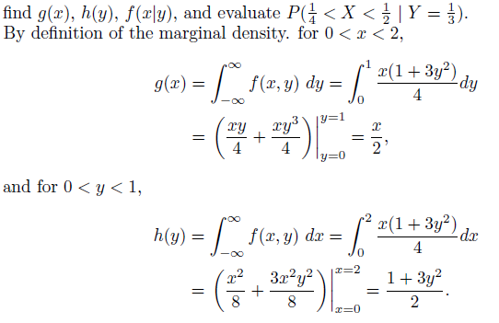

Slide 23
